Slide 1
Fit-Pro
Angular Project
By:Bhargav Kumar

Slide 2
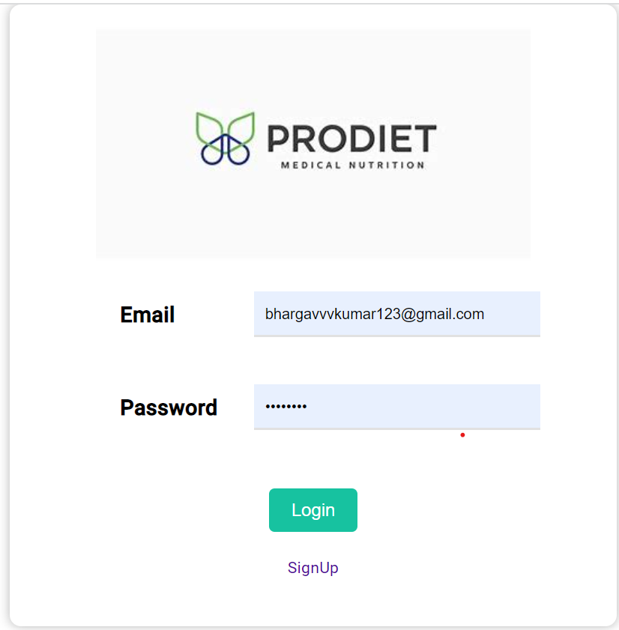
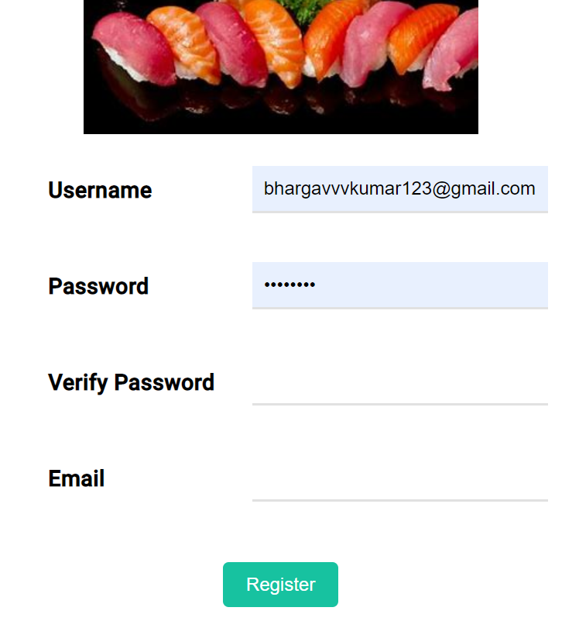
Login Component
-User Login
-Admin Login
-Registration

Slide 3
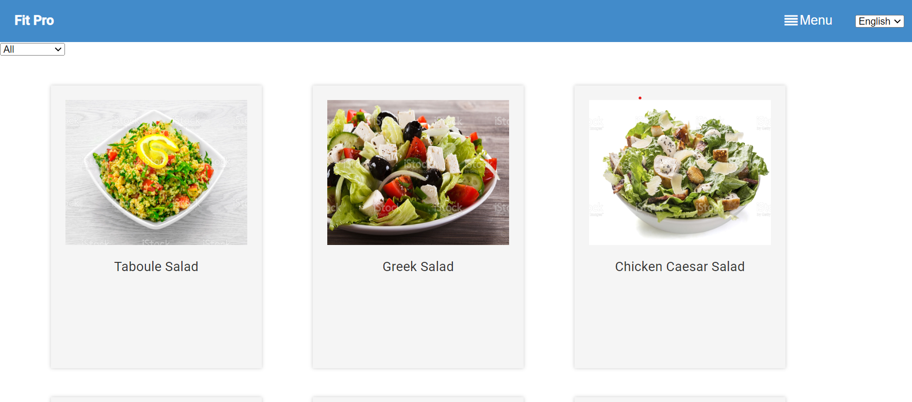
User-Home:
-This page consists of Different types of products with type filter
That makes user easy to search a product.
-By clicking on the product user will get that product Protein%, Fat%, Calories,Carbs%.
-Internationalization that makes user easier to search for a product in their own language.
-Inside menu button there are 4 options diet-plan, create, Forum,logout.

Slide 4
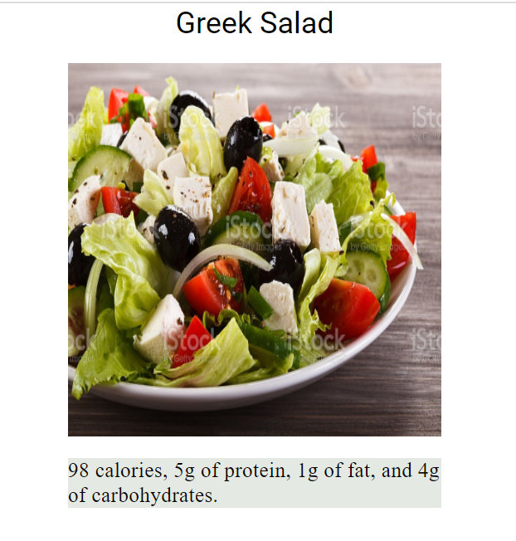
Product-Details
By clicking on the particular product user can get to know their nutrition-value.

Slide 5
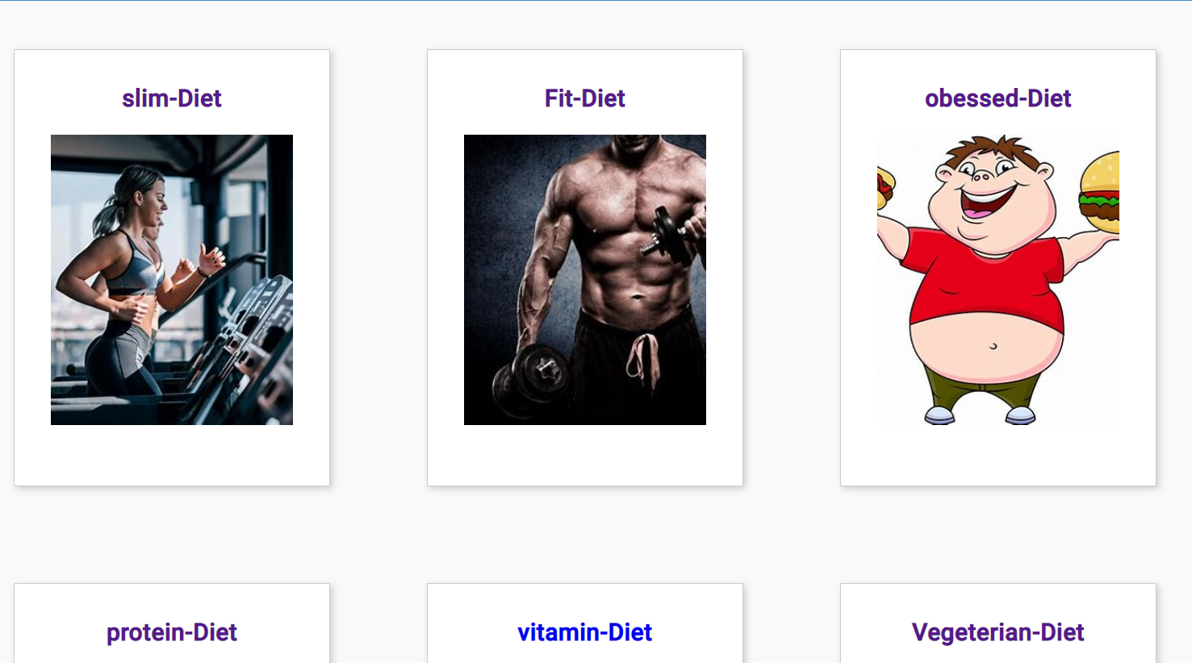
User-Diet-Plan:
-There are different type of diets available in this page.
-User can select any of diet based on their wish.
-Initially the details of diet are hidden.

Slide 6
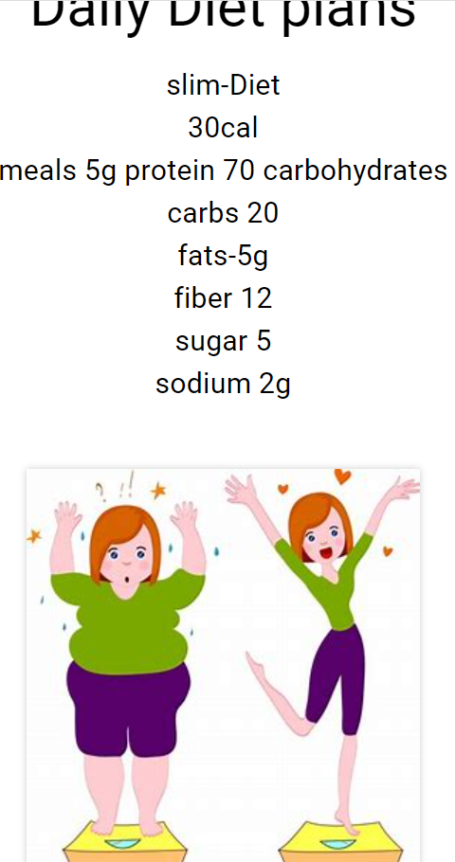
User-Diet-Details:
-If we click on the Diet-Type it routes to the details of that particular diet-type.
-That makes user to follow the particular diet.

Slide 7
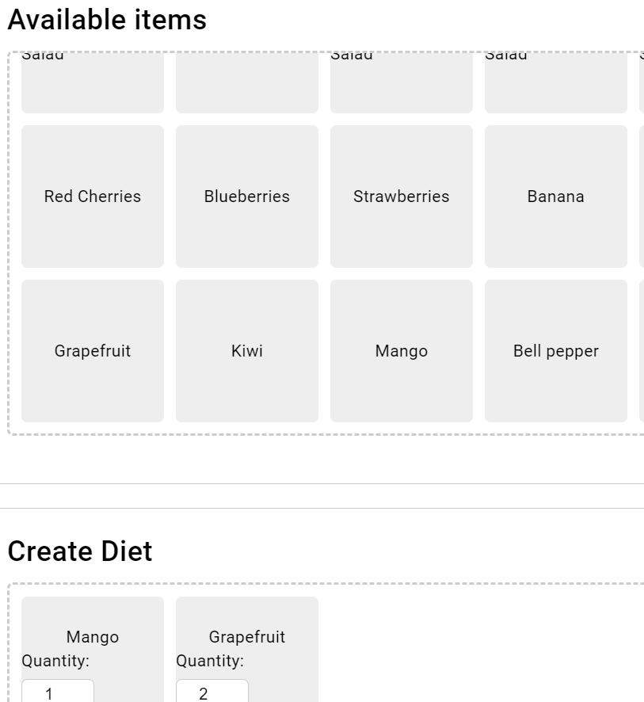
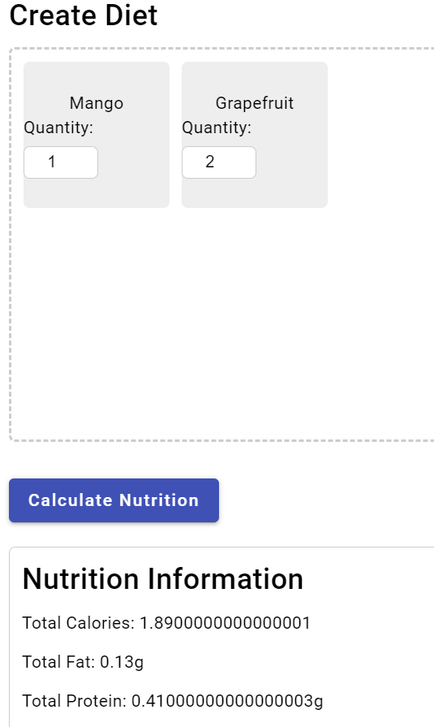
Creating-Dietplan
-This page helps user to create their own diet-plan.
-This page displays all the products and their nutrition value which is initially hidden.
-By -drag and dropping the product into create diet it asks user to enter quantity.
After entering all products and quantities that are needed for user. By clicking on calculate nutrition button it displays nutrition information of that particular diet.

Slide 8
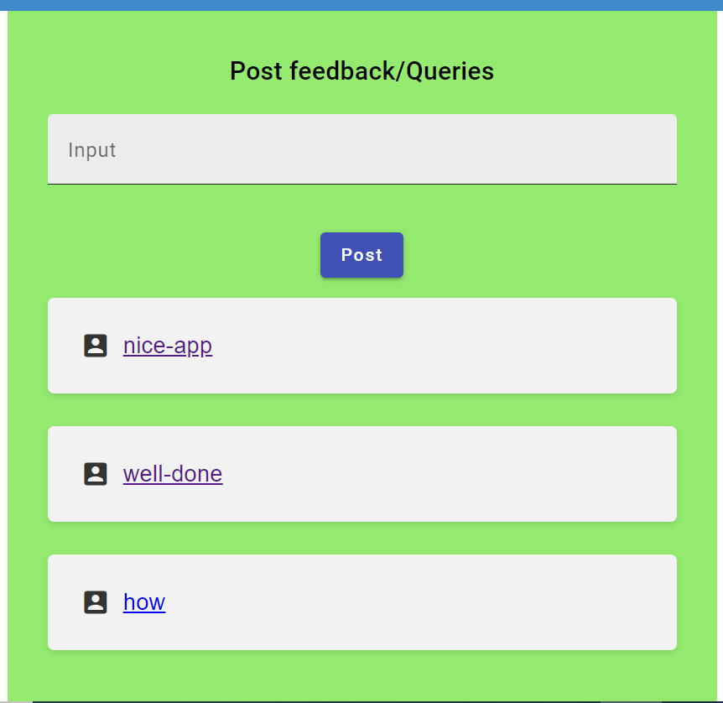
User-Forum:
-In this page user can post feed-backs or can ask questions to the admin.
-User can see other users feedbacks.

Slide 9
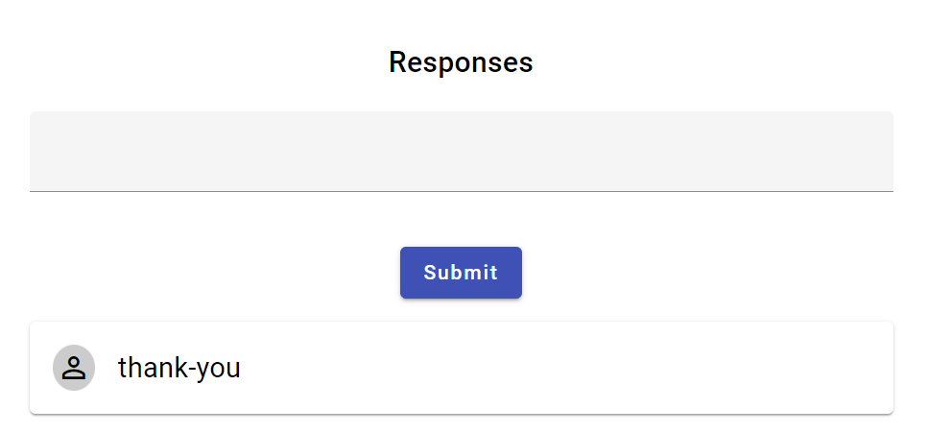
-By clicking the question user can see response for that particular question .
-If no one is responded for that question it displays blank.

Slide 10
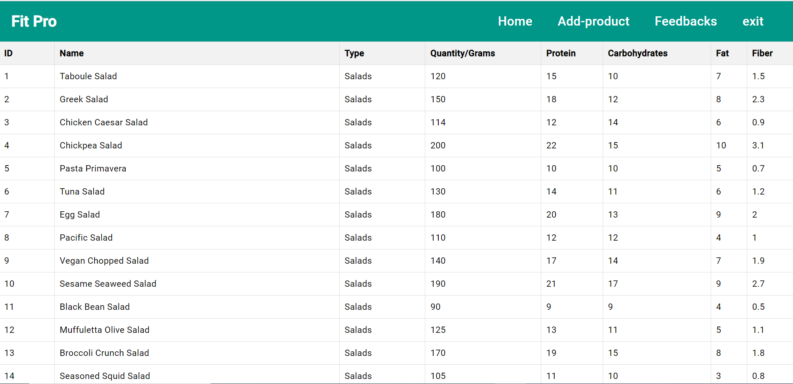
Admin-Home:
Admin-Home
-In admin home by default it displays all the available products and their nutrition value,

Slide 11
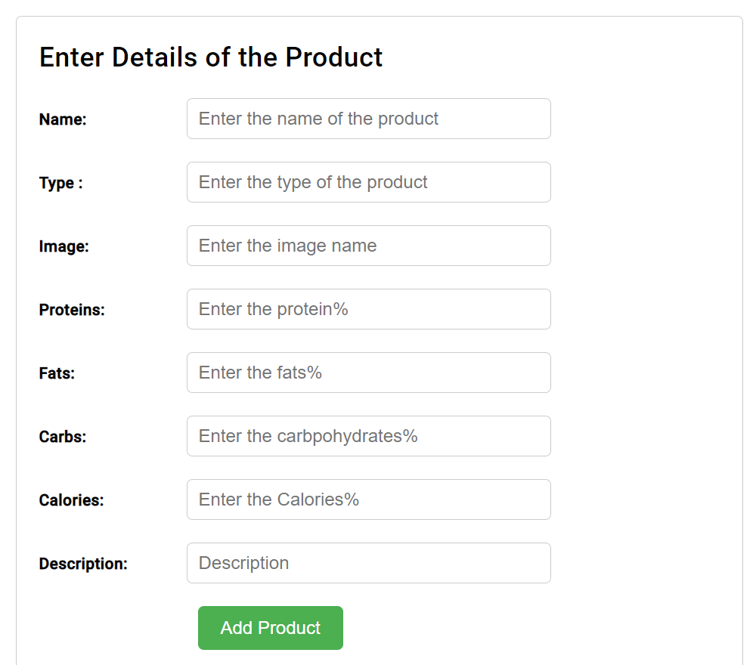
Add Product:
.This component makes the admin to add the product by entering name, Image, Nutrition values present in it.
-The added product will be shown in list of products that user can saw.
-This page is completely validated.

Slide 12
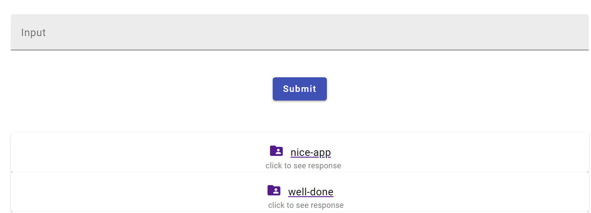
Admin-Response
-This component can be used by the Admin to respond to the question that is asked from the user.
-This answer can be able to see by the user if they click on that particular question.

Slide 13
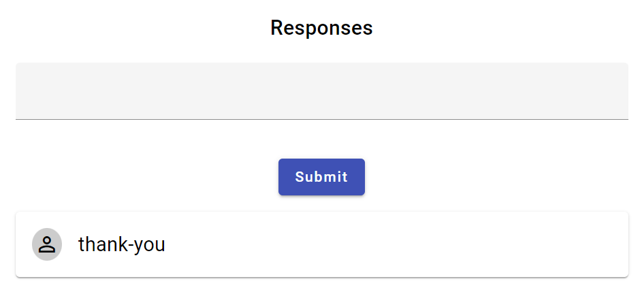
-By clicking on the question Admin can also see other responses which are given by different users.

Slide 14
Log-out:
-A user or admin can easily logout.
-In user by clicking on logout icon and in admin by clicking exit button
.

Slide 15

Thank You

